Slide 1
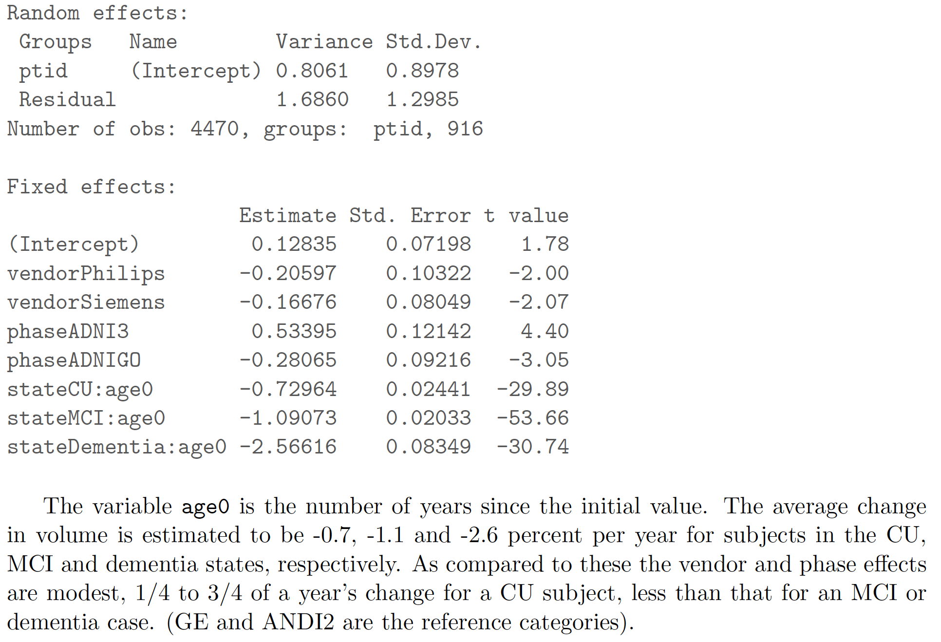
TBM-SyN (spm5-based) effects of ADNI phase, vendor
Conclusion: Modest vendor and phase effects compared to age or diagnosis effects

Slide 2
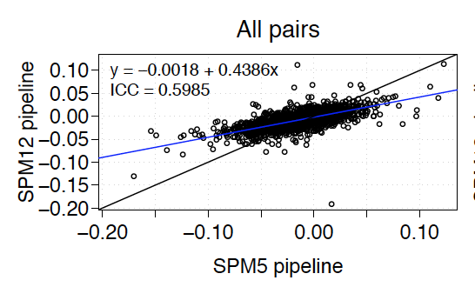
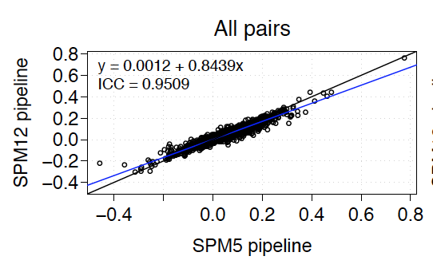
TBM-SyN algorithm updates in progress
Tissue segmentation updated from spm5- to spm12- based method
Templates, priors, atlas ROIs updated from STAND400 to MCALT
Atlas to subject transformation updated from spm5 to ANTs
Comparisons on subjects who did not change scanners
Ann. Log Jacobian AD meta-ROI
Ann. Log Jacobian Ventricles

